Slide 2
Multi-Tenant Architectures in Software-as-a-Service Solutions
Rainer Stropek
Co-Founder, CEO, Developer
software architects gmbh

Slide 3
Goals
Why should I care?
What does multi-tenancy + SaaS mean?
How can the problems be solved?
This is the architecture track
This is an interactive session

Slide 4
Why should I care?

Slide 5
PLEASE READ (hidden slide)
This template is designed for use with Office PowerPoint 2007 and 2010. The charts and graphics can be edited with PowerPoint 2007 and 2010, but not with PowerPoint 2003.
This template uses Microsoft Segoe UI, a standard font that is included in Office 2007, Office 2010, Windows Vista and Windows 7.

Slide 6
Notes (hidden)
Some speakers at Microsoft like to use this slide for hidden “notes slides”.
Delete it if you don’t want to use it.
NEXT: <next slide title>

Slide 7
Rules Are Changing
Under Creative Commons License Source: http://www.flickr.com/photos/spursfan_ace/2328879637/

Slide 8
Rules Are Changing
Custom
Standardized
One Customer
Many Customers
On Premise
Software as a Service
Strongly Typed
Duck typing
Early Binding
Late Binding
…
…
Under Creative Commons License Source: http://www.flickr.com/photos/yjv/2910922647/

Slide 9
Where Most Of Us Come From
Customer
Dev Team
Close Relationship

Slide 10
Where Many Of Us Are Today
External/New Customers
Customer
Kunde
Kunde
Kunde
Kunde
Dev Team
Customer
From Cost Center to Profit Center!

Slide 11
Where We Want To Be
Customer
Off-The-Shelf Product
Kunde
Kunde
Kunde
Kunde
Kunde
Kunde
Kunde
Dev Team
Kunde
Kunde
Kunde
Kunde
Kunde
Kunde
Kunde
Kunde
Kunde
Kunde
Kunde
Kunde
Kunde
Customer
Kunde
Kunde
Kunde
Kunde
Kunde
Kunde
Kunde
Kunde
Kunde
Kunde
Custom
Kunde
Kunde
Kunde
Custom
Kunde
Kunde
Kunde
Custom
Kunde
Kunde
Custom
Kunde
Custom
Customer

Slide 12
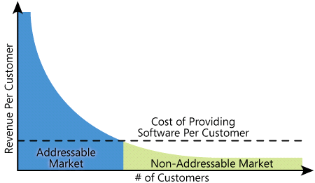
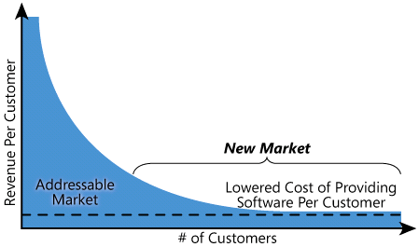
Catching The Long Tail
The Long Tail http://www.wired.com/wired/archive/12.10/tail.html

Slide 13
One Size Does Not Fit All
Under Creative Commons License Source: http://www.flickr.com/photos/mava/2445734571/

Slide 14
What does multi-tenancy + SaaS mean?

Slide 15
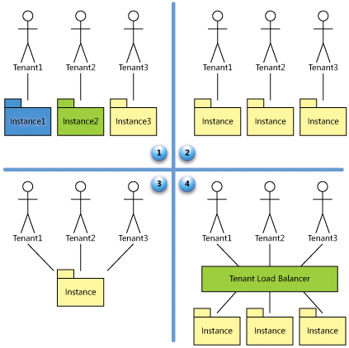
Multi-Tenancy
Multi-Instance (ASP)
Custom Solution With Common Components
SaaS Maturity Levels Kwok, Nguyen, Lam: A Software as a Service with Multi-tenancy Support for an Electronic Contract Management Application, IEEE International Conference on e-Business Engineering, pp. 179-186, 2008
Multi-Tenancy
Multi-Tenancy

Slide 16
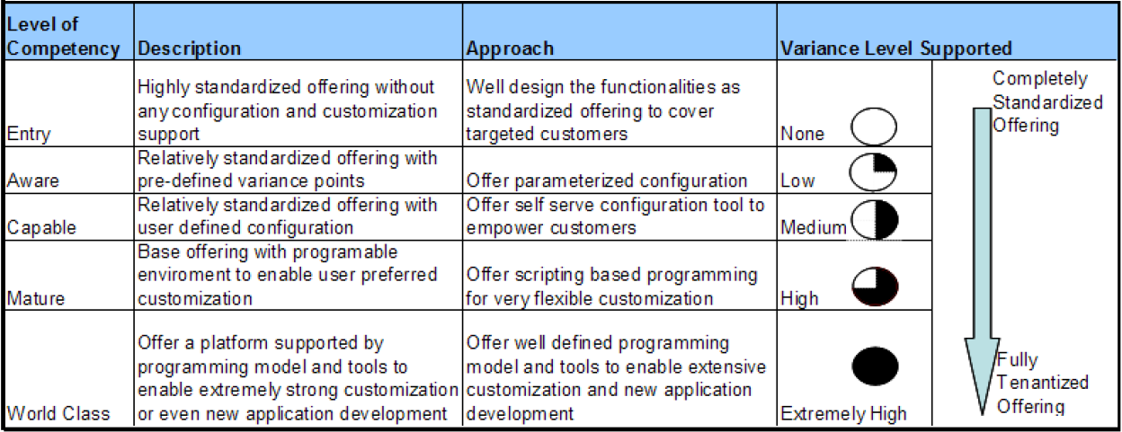
Extensibility And Customization
SaaS Configuration Competency Model Wei Sun, Xin Zhang, Chang Jie Guo, Pei Sun, Hui Su: Software as a Service: Configuration and Customization Perspectives, in Proceedings of IEEE Congress on Services Part II, 2008

Slide 17
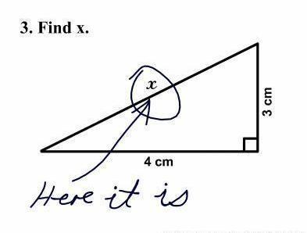
How can the problems be solved?
Under Creative Commons License Source: http://www.flickr.com/photos/dullhunk/426622486/

Slide 18
Metadata Rulez!
Configuration Instead Of Programming
Different Metadata Management

Slide 19
Metadata Management SaaS Maturity Levels 3 and 4
Common Codebase
Updating can be quite hard
Eliminate any per-server configuration
Move configuration information away from configuration files
Caching architecture is crucial
Develop and test using load balanced environments

Slide 20
Metadata Rulez!
Database
Mapping
Data Structures
Data Model
Business Processes and Logic


User Interface
Authentication and Authorization

Slide 21
Data Model
Database
Mapping
Data Structures

Slide 22
Why Bothering? Use an ORM!?
Example: Microsoft‘s Entity Framework
Advantage of EF = Disadvantage in SaaS scenarios
Type safety through generated code
Early binding
Under Creative Commons License Source: http://www.flickr.com/photos/dullhunk/426622486/
SaaS often means programming against a (partly) unknown data model

Slide 23
Metadata Management
Domain-specific Structure and Logic
Domain-specific Structure and Logic
Domain specific Model
Controls
Domain specific Data Access and Query Layer
Application
Generate
Serialize
SQL, ODATA, etc.
Tenant specific Database
Metadata
Security: Prevent cross-tenant data access

Slide 24
Example: XAML-based Data Model
<Model […]>
<Model.Entities>
<ModelEntity Name="Project" SyncBehavior="ModelAndData">
<ModelEntity.Properties>
<TextProperty Name="ProjectName" IsDefaultDisplayProperty="True"/>
[…]
</ModelEntity.Properties>
<ModelEntity.Relations>
<Relation Name="CustomerRelation" Target="{ModelRelation Customer}"
BackReferenceName="Projects" />
[…]
</ModelEntity.Relations>
<ModelEntity.ValidationRules>
<ValidationRule Name="SomeName" Condition=":Iif(Current.ProjectName='Test', True, False)"
Message="Invalid Projectname"/>
</ModelEntity.ValidationRules>
</ModelEntity>
</Model.Entities>
</Model>

Slide 25
One DB Per Tenant – SQL Generation Generate SQL Using Template Engine (Simplified)
group DataModelTemplates;
CreateTable(context, entity) ::=
<<
CREATE TABLE [<context.Tenant>].[<entity.Name>]
(
<entity.Name>Uuid uniqueidentifier NOT NULL,
<entity.Properties:{ p | <p:(p.Type.Name)()>}; separator=",\n">
)
ALTER TABLE [<context.Tenant>].[<entity.Name>] ADD CONSTRAINT
DF_<entity.Name>_<entity.Name>Uuid DEFAULT newid() FOR <entity.Name>Uuid
ALTER TABLE [<context.Tenant>].[<entity.Name>] ADD CONSTRAINT PK_<entity.Name> PRIMARY KEY CLUSTERED ( <entity.Name>Uuid )
>>
TextProperty(property) ::= "<property.Name> varchar(50) NULL„
NumericProperty(property) ::= "<property.Name> numeric(18,4) NULL”
Tenant separation
DB design convention

Slide 26
Data Maintenance Generate SQL Using Template Engine (Simplified)
group DataTemplates;
SaveObject(context, object) ::=
<<
<if(object.IsNewEntityObject)>
insert into [<context.Tenant>].[<object.Entity.Name>] (
<object.Entity.Name>Uuid,
<object.Entity.Properties:{ p | <p.Name>}; separator=", ">
) values (
@Uuid,
<object.Entity.Properties:{ p | @<p.Name>}; separator=", ">
)
<else>
update [<context.Tenant>].[<object.Entity.Name>]
set <object.Entity.Properties:{ p|<p.Name>=@<p.Name>}; separator=", ">
where <object.Entity.Name>Uuid = @Uuid
<endif>
>>
Tenant separation

Slide 27
Combining Strong Type Checking And Extensibility
[ModelEntityInterface]
public interface IDuration
{
DateTime BeginTime { get; set; }
DateTime EndTime { get; set; }
decimal DurationInHours { get; }
}
[…]
IDuration timesheet = context.Timesheet.CreateEntity<IDuration>();
timesheet.BeginTime = DateTime.Now;
[…]
dynamic timesheet = context.Timesheet.CreateEntity<EntityObject>();
timesheet.Description = "This is a new timesheet!";
[…]
Strong type checking
Dynamic extension

Slide 28
Tips For Metadata Management (1/2)
From model to SQL using a template engine
E.g. we use StringTemplate from ANTLR and T4 from Microsoft
Support for multiple storage engines easy to implement
Automate DB design conventions
Make model simple by offering domain specific extensions
E.g. data types, functions, multi language support, etc.
Security layer for multi tenancy

Slide 29
Tips For Metadata Management (2/2)
Use metadata infrastructure of underlying systems
E.g. create DB tables instead of name/value pair storage
Dynamic instead of OO
DLR can build the bridge from OO to dynamic
Use strong type checking wherever possible
We use interfaces for that
Semantic validation of model to reduce # of runtime errors
XAML is a nice tool to build a XML-based DSL for metadata model
Better than pure XML: No additional schema
Better than code: Clear separation between model and logic

Slide 30
Yet Another ORM? No!
Not object oriented
Very domain-specific
Convention vs. versatile
No code generation
Duck typing instead of strong type checking at compile time (see also next chapter)
If you do not need a customized data model don‘t do it!

Slide 31
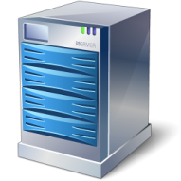
Tenant Separation (1/2)
Virtual or physical server per tenant
Multi instance instead of multi tenant
One DB per tenant
Separation using schemas
Shared tables

Slide 32
Tenant Separation (2/2)
One DB per tenant
Overhead for small tenants
Strict separation of tenants
Separation using schemas
Backup/restore is harder
Authorization easy to set up
DB sharing can help to efficiently handle small tenants
Shared tables
Development effort
Authorization has to be implemented manually
Can be efficient if tenants have identical/similar data structures

Slide 33
Designing The Tenants’ Databases
Structurally identical DB for all tenants
Key/value pair storage
Implements a database inside a database
Use XML/BLOBS for customizations
Hard to maintain and query
Reserved fields
Limited customization possibilities
Inefficient (with regards to storage)
Change DB structure on the fly
Uses capabilities of the underlying storage
Open for the use of e.g. standard query tools
Self-describing
Parts of the model are inside the storage engine
This is what we use to simplify metadata repository structure
This is what we do at time cockpit

Slide 34
Processes And Logic

Business Processes and Logic
User Interface

Slide 35
Programming Model Internal And Public API
Let people access DB directly
SQL is already dynamic
Possible for reading, big problem for writing (sync!)
Generate code
Good for multi instance, bad for multi tenant
Declarative
Graphical (e.g. WF) and textual (e.g. DSLs, X(A)ML) are possible
Great for common scenarios, doesn‘t work for everything
Key/value pair model
Similar to DataTable, DataReader, etc.
Hard to write, hard to read
Dynamic languages
DLR is a great platform for that

Slide 36
time cockpit‘s Customization Architecture Example
Dynamic Objects (DLR)
Basis for dynamic language support
Declarative UI engine
Query Results
Persist
Model (XAML and DLR enabled)
TCQL (time cockpit Query Language) ≈ VB LINQ
TC Expression Language
“Floating” business logic
Compile
Compile
Data Store
Expression Trees
SQL, REST, ODATA

Slide 37
time cockpit‘s Customization Architecture Example
Expression Trees
Custom logic executed in UI layer (data binding)
Model: Calculated Property DurationInHours = Current.EndDate – Current.StartDate
Customized logic (functional expression language)
TCQL: From T In Timesheet Select T Where T.DurationInHours > 4
Tenant filter injection
SQL: select […] from <Tenant>.Timesheet where datediff(…) > 4
Custom logic executed in DB layer

Slide 38
Script-based Model and Data Maintenance
model = Context.GetWritableModel()
flatDim = ModelEntity()
flatDim.Name = "Customer"
model.Entities.Add(flatDim)
model.Customer.Properties.Add(
TextProperty({ "Name": "CustomerName", "MaxStorageSize": 50 }))
[…]
Context.SaveModel(model)
[…]
customer = Context.CreateCustomer()
customer.CustomerName = "C01"
Context.SaveObject(customer)
Model
In C# 4 we can use dynamic keyword
Data

Slide 39
Where To Use What
CLR Languages And Scripting
Declarative
Offer vertical business templates for time tracking
Interface development
Actions
Predefined and customized
Flexible binding mechanisms to support CLR- and WF-based actions (bridge to declarative world)
UI definition
Forms and lists (incl. queries)
Color schemas
Runtime environment for the model
Calculated properties
Validation rules
Default values
Exports for reporting

Slide 40
DSL For Form Definition Declaration of UI using XAML-based DSL
<Form ModelEntityName="APP_Timesheet" […]>
<Tab Header="Zeitbuchung">
<Section Header="Allgemein">
<DurationCell BeginTime="=Current.APP_BeginTime"
EndTime="=Current.APP_EndTime" Header="Zeitraum" />
<BoundCell Content="=Current.APP_Description" />
</Section>
<Section Header="Projekt">
<RelationCell Content="=Current.APP_Project"
List="APP_DefaultProjectList" SortDirection="Descending" />
</Section>
<Section Header="Verrechnung">
<NumericCell Content="=Current.APP_HourlyRateProjectOrTask"
NumberFormatPattern="#,##0.00" />
<BoundCell Content="=Current.APP_NoBilling" />
</Section>
</Tab>
[…]
</Form>

Slide 41
DSL For List Definition Declaration of UI using XAML-based DSL
<List […] EditFormName="APP_TimesheetForm"
Query="
From Current
In APP_Timesheet.Include('APP_UserDetail')[…]
Order By Current.APP_BeginTime
Select Current">
<BoundCell Content="=Current.APP_UserDetail" />
<NumericCell Content="=Current.APP_HourlyRateActual"
NumberFormatPattern="#,##0.00" />
[…]
</List>

Slide 42
Tips For Customization (1/2)
DLR is a great platform to build on
Also possible if you still use C# 3
Data binding customization is necessary (big problem in Silverlight 3)
Mix of predefined and customized data model
We use interfaces for that → strong type checking where possible
Don’t forget to have a defined way for updating your model!
Don’t think that combination of multi-tenancy and customization is easy!
Don’t do it if you don’t need it!

Slide 43
Tips For Customization (2/2)
Don’t design new languages if this is not your primary goal
Use and/or extend existing ones
E.g. TCQL is very similar to VB LINQ
Make common domain-specific scenarios as simple as possible
Declarative instead of scripts
Query and expression language go hand in hand
Use tools for implementing domain specific languages
Graphical or textual
X(A)ML is the easy way → time cockpit’s UI

Slide 44
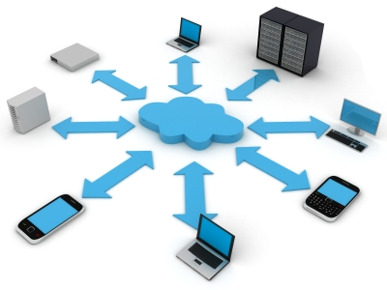
How Everything Comes Together
Photo Sources: http://www.istockphoto.com/file_closeup.php?id=11455462
http://www.istockphoto.com/file_closeup.php?id=9588509

Slide 45
Multi-Tenant Smart Client Architecture Example
Windows Azure Platform
User
Registration
CMS
Web Role
time cockpit
Download, Install
Msg.
Queue
Tenant Directory
Local Cache
Authentication and Discovery Web Service (Web Role)
Sync
MS Sync Framework Custom Sync Provider
Create
Tenant Data Store
Tenant Maintenance Worker Role
Tenant DB
Tenant BLOB Store

Slide 46
Tips For Multi-Tenancy In Azure
Don‘t forget caching
Technical architecture has to support your business model
Efficiently use expensive Azure resources
Design to scale
Multi-tenancy from the first day
Hard to add it later
You need to have a clear update strategy for high availability

Slide 47
Conclusion
Cloud computing enables people
There will be more competition
It‘s not easy
Complexity comes from multi-tenancy + customization
Try to be as static as possible and as dynamic as necessary
Under Creative Commons License Source: http://www.flickr.com/photos/laurie_pink/2599768757/

Slide 48
Thank you for your attention!
rainer@timecockpit.com Twitter: @rstropek
Questions?

Slide 49
© 2010 Microsoft Corporation. All rights reserved. Microsoft, Windows, Windows Vista and other product names are or may be registered trademarks and/or trademarks in the U.S. and/or other countries.
The information herein is for informational purposes only and represents the current view of Microsoft Corporation as of the date of this presentation. Because Microsoft must respond to changing market conditions, it should not be interpreted to be a commitment on the part of Microsoft, and Microsoft cannot guarantee the accuracy of any information provided after the date of this presentation. MICROSOFT MAKES NO WARRANTIES, EXPRESS, IMPLIED OR STATUTORY, AS TO THE INFORMATION IN THIS PRESENTATION.

